Slide 1
Google Cloud Platform

Slide 2
Organization
Folders
Projects
Resources
IAM (Identity and Access Management)
Policy Inheritance
Resources and Access in the Cloud

Slide 3
Role-Based Access Control (RBAC)
IAM Policies
Predefined Roles
Custom Roles
Service Accounts
IAM Best Practices
Access Transparency
Identity and Access Management (IAM)

Slide 4

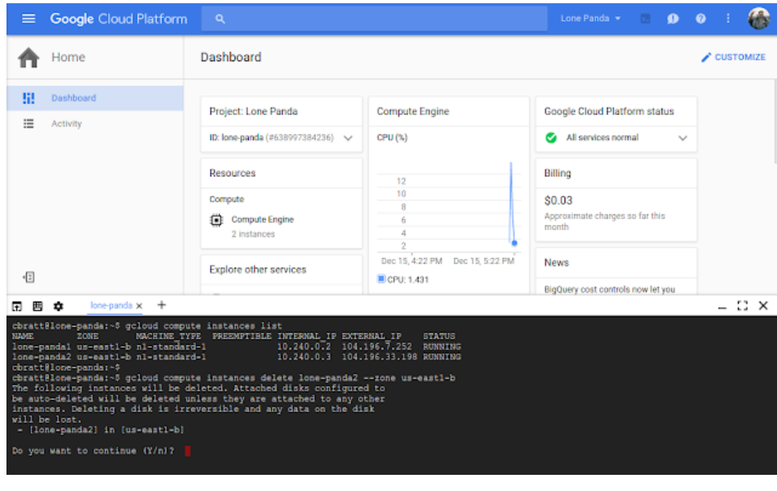
Interacting with Google Cloud
https://cloud.google.com/shell/docs
Cloud Console

Slide 5
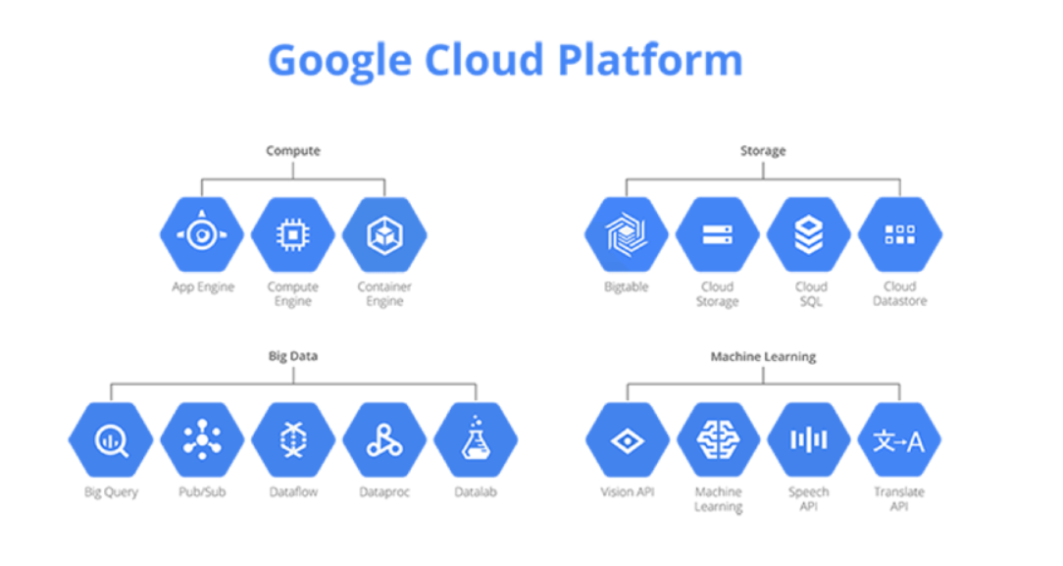

Slide 6
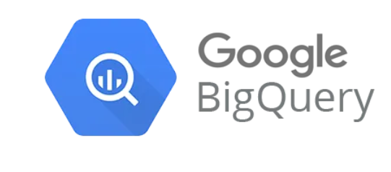
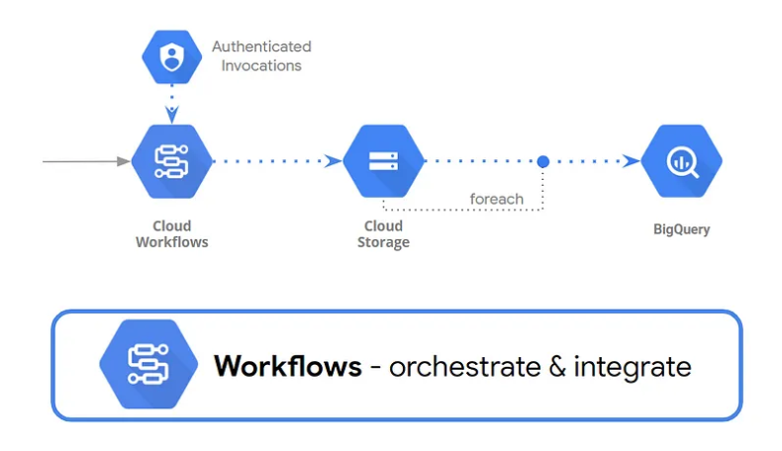
Typical Use Cases:
Data Warehousing
Business Intelligence (BI)
Real-Time Analytics
Machine Learning
ETL (Extract, Transform, Load)
Serverless Architecture
High-Speed Data Analysis
Real-Time Analytics
Integration with Google Cloud Services
Machine Learning Integration

Slide 7
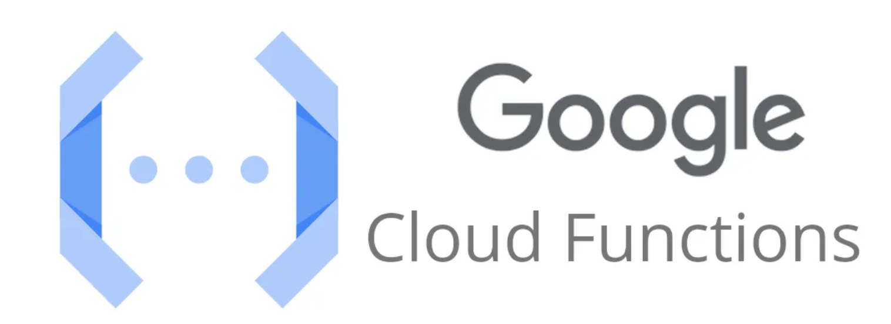
Serverless Computing
Event-Driven Execution
Flexible Deployment
Pay-As-You-Go
Machine Learning Integration

Slide 8
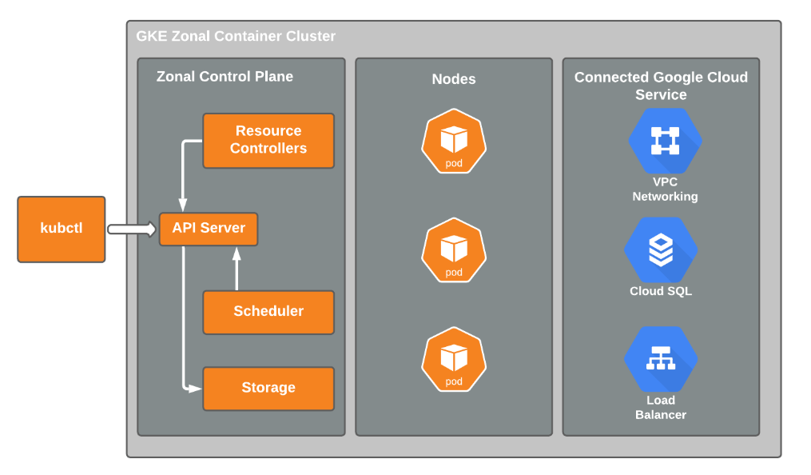
Google Kubernetes Engine
Container Orchestration and Scalability

Slide 9
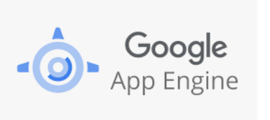
Google App Engine is a platform-as-a-service (PaaS) offering from Google Cloud Platform (GCP) that enables developers to build and deploy scalable web applications and mobile backends.

Slide 10
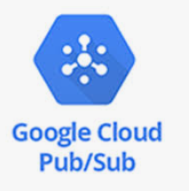
Asynchronous Messaging Real-Time Analytics Event-Driven Architectures

Slide 11
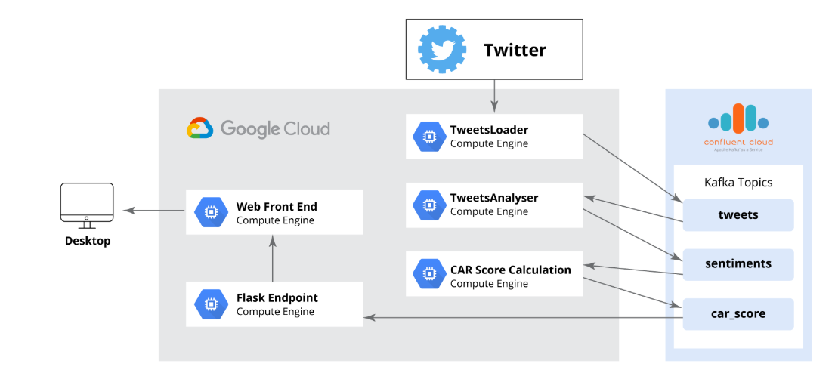
Confluent Kafka on GCP
Confluent Kafka on GCP offers a fully managed streaming service based on Apache Kafka, providing seamless integration with GCP services, simplified operations, and robust scalability and reliability. It's ideal for developers looking to build real-time data pipelines without the operational overhead.

Slide 12
Why Choose Confluent Kafka on GCP?
Fully Managed Service
Integration with GCP
Scalability and Reliability
Rich Ecosystem

Slide 13
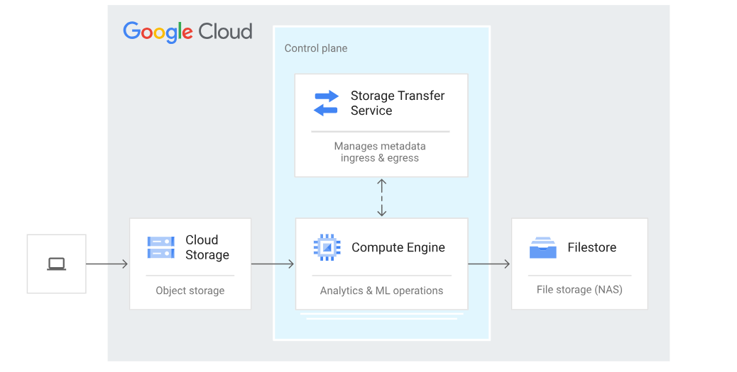
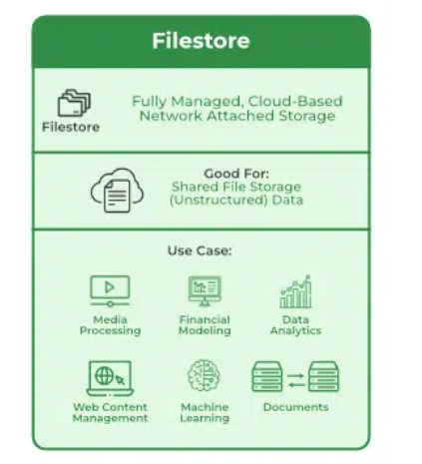
Filestore Tiers
Basic HDD (Standard)
Basic SSD (Premium)
Zonal
RegionaL
Enterprise

Slide 14
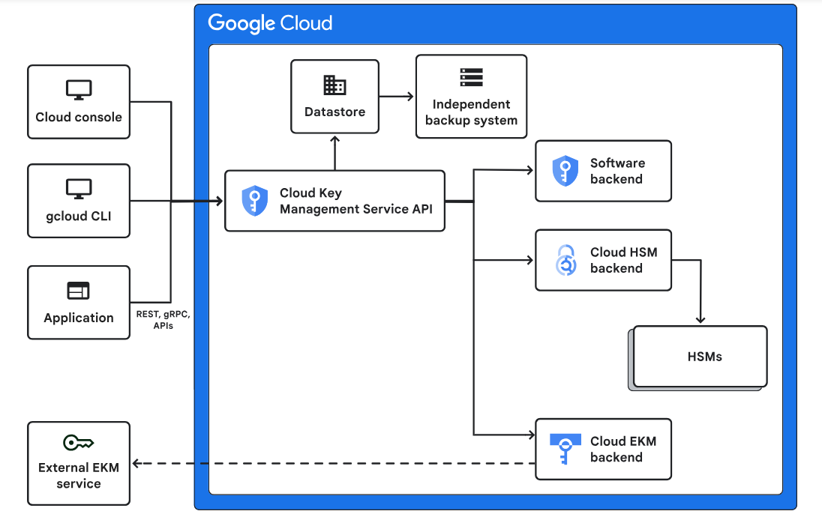

Slide 15
Create a Key Ring: Start by creating a key ring to organize your keys.
Create a Key: Generate a cryptographic key within the key ring.
Import a Key: Import existing keys into Google Cloud KMS.
Use the Key: Integrate KMS with your applications to encrypt and decrypt data.
How to Get Started With KMS

Slide 16
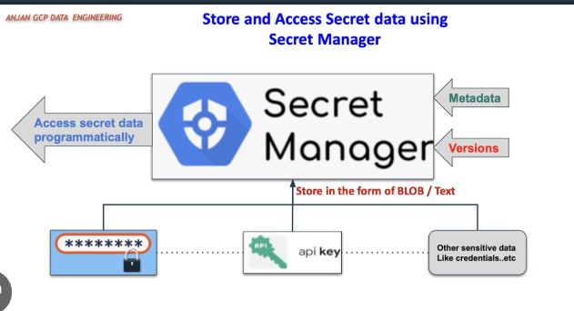
Pricing
Storage Costs: Per secret stored.
Access Costs: Per API call to retrieve
or modify a secret.

Slide 17
Cloud Monitoring (formerly Stackdriver Monitoring)
Cloud Logging (formerly Stackdriver Logging)
Cloud Trace
Cloud Profiler
Cloud Debugger
Ops Agent
BigQuery
Observability

Slide 18
Collect Analyze Act Optimize
Integrated Observability Workflow
Use Cases
Performance Monitoring Incident Management
Benefits of GCP Observability Toolset
Comprehensive Insights
Scalability
Real-Time Monitoring

